Slide 1

Suicide Rate Analysis
DSCI 511
GROUP 5

Slide 2

Team Members and Responsibilities
Abhishek Shetty : Worked on Data Set research, data-acquisition, manipulation, web-scraping.
Srinivas Pai: Worked on Data manipulation, web-scrapping and merging all the data sets
Anamika Rekha: Worked on Data Set research, data-acquisition, manipulation and evaluation.
Siddharth Dudugu: Worked on Data preprocessing, manipulation, evaluation and web-scrapping.
Jibin Joby: Worked on the analysis, visualization and the uploading to GitHub and Kaggle.

Slide 3
Overview
Through our data we have found out the countries that have the highest suicide rates and then provided insights on it with the help of various parameters that could be a reason for suicide attempts.
After we acquire the dataset from various websites, we did web scraping to add additional values in our dataset and then data preprocessing, manipulation merging and analysis.
The goal of the project is to provide insights to Suicide prevention agencies ensuring the target population is taken care of first, which would eventually save more lives.

Slide 4
The Data Source
WHO Dataset
https://apps.who.int/gho/data/node.main.MHSUICIDE10YEARAGEGROUPS?lang=en
https://apps.who.int/gho/data/node.main.MHFAC?lang=en
https://apps.who.int/gho/data/node.main.MHPOLFIN?lang=en
https://apps.who.int/gho/data/node.main.MHSUICIDEASDR?lang=en
https://apps.who.int/gho/data/node.main.MHHR?lang=en
https://apps.who.int/gho/data/node.main
GDP by country: Web Scraping
https://www.worldometers.info/gdp/gdp-by-country/
Happiness Index
https://worldpopulationreview.com/country-rankings/happiest-countries-in-the-world
Literacy rate
https://worldpopulationreview.com/country-rankings/literacy-rate-by-country

Slide 5
The Constructed Dataset
Suicides, Country, Age Group, Sex, Year: This WHO dataset had the number of suicides per 100,000 people, age group with an interval of 10 years, sex of the individual, combined suicide rate for both sexes and the countries.
Link: https://apps.who.int/gho/data/node.main.MHSUICIDE10YEARAGEGROUPS?lang=en
GDP , %GDP growth: To acquire this data we scraped through the web to extract the desired values for the countries, GDP and % GDP growth.
Link: https://www.worldometers.info/gdp/gdp-by-country/
Mental Health Expenditure: For the mental health expenditure we have extractracted our parameters from two of WHO's data set. It has multiple variables like expenditure of government on mental hospitals, mental hospital count, mental health day treatemen facilities,Psychiatrists working in mental health sector etc.
Facilities Link: https://apps.who.int/gho/data/node.main.MHFAC?lang=en
Mental Health Governance: https://apps.who.int/gho/data/node.main.MHPOLFIN?lang=en
Human Resourses: https://www.who.int/data/gho/indicator-metadata-registry/imr-details/2954
Drug Addiction: The drug abuse data was acquired through the ourworldindata which shows the percentage drug abuse in each country.
Link: https://ourworldindata.org/drug-use
Happiness Index: The happiness index for each of the countries was procured from the worldpopulationreview website. This shows the happiness index for each of the countires on a scale of 1-10.
Link: https://worldpopulationreview.com/country-rankings/happiest-countries-in-the-world
Literacy Rate: The literacy rate data was extracted from the world population review data that shows the literacy of a country in percentage.
Link: https://worldpopulationreview.com/country-rankings/literacy-rate-by-country
Population: The population for each of the countries was derived from the worldpopulationreview. This gives the population for each of the counties.
Link: https://worldpopulationreview.com/

Slide 6
Access Rights
All our data set was fetched through websites that are publicly available and can be publicily accessed and distributed.
As there are no such restrictions on our data, we can easily make use of the readily available dataset and transform each of the dataset as per our needs.
We are distributing our source code along with the data sets on Kaggle and GitHub.

Slide 7
Acquisition & Preprocessing Approach
CSV & Web Scraping
CSV:
Data Search: The parameters like suicides, country, GDP, Drug Addiction etc. were all found from websites like WHO, ourwouldindata, worldpopulationreview etc.as a CSV file.
Data Manipulation: The CSV for each of the files had multiple columns.
While many of the columns were not needed, we processed the dataset to drop the columns that were not needed.

Slide 8
To manage the specific year, we computed it by making the parameter a function of random percentage values between –3 to 9. The values were set so as to standardize the data, and to prevent any biases or unintended over-estimate.
While some values for the year 2019 were missing we extrapolated it to give the values for the year 2019.
A single main file was created with desired columns from each of the direct CSV & Web Scraped site.
Data Cleaning: Each of the dataset had multiple rows with no entries. We ensured that these counties were given a NaN value if it didn’t have any specific value for that column.

Slide 9
Web-Scraping:
We did web-scraping on the GDP growth website to get the values for the Countries, GDP and % GDP growth.
Through our web scraping, we used beautiful soup module to parse through the HTML document.
The "a" and "td" tags helped us retrieve the values for each of the columns.
Regular expressions were used to eliminate the $ and % values from the extracted numbers.

Slide 10
Potential Users
Government Agencies: Through our data set the government could track the relative suicide rate for counties similar to theirs in terms of size, economy, geography, etc., and then analyze the areas where it needs to improve through our variables to reduce suicides. E.g. Setting up new mental health hospitals, expenditure on mental health, increasing the number of psychologists etc.
Social Work Organizations: The social camp organizers can fill in the gap to meet the needs of citizens to have professional mental health practitioners and guides. It could also analyze the uneven split of suicide rates among men and women and target the population that is hit hardest among the entire set in any given country.
Paramedics: The paramedics in any country could analyze the need for mental health workers and increase their workforce to meet the needs as per the demand for the country.
Suicide Hotline Numbers: Suicide hotline number could set a plan to observe the suicide trend in terms of age group, sex etc. and set us a constructive plan to ensure reduction on suicide among these categories.
Business sector: The business sector could co-relate with the happiness index, mental health employee counts, etc. before setting up a business. The ones who already have a business set in a country could set up boot camps regarding suicide prevention for their employees and people in general. Upcoming companies could also come up with suicide prevention and detection products in countries with high suicide rates.

Slide 11
Challenges Faced
Acquiring Data: While some datasets were readily available, there were a lot of data which were hard to find, however, the WHO website proved to be very useful to fulfill our data needs for a very niche type of data set.
Preprocessing & Cleaning: While processing the data, it was very important to drop all unwanted rows and columns. At the same time, while some of the data were not up for the year 2019, we had to make assumptions in order to derive the values for some columns. We also ensured that all data points with no values were replaced by NaN to ensure consistency.
Merging: The biggest challenge we faced was merging the data from all the datasets into one final file. While all other dataset had a different column for countries, we solved this problem by merging on counties using a full outer join.

Slide 12
Limitations
Missing Values: While the data is available, some parameters are not as widely reported by many countries.
Assumption: When manipulating the data, a couple of variables were created with the column in years considering random values from -3 to 9 in order to ensure standardization. However, in real work scenario this value can be changed to the global trend in each of the parameter.
Formatting: While extracting the data, some of the countries were named differently in each of the data set. This created the problem where for example we had two rows one with United States and the other with United States of America. Although both are the same countries the nomenclature caused this kind of issue.

Slide 13
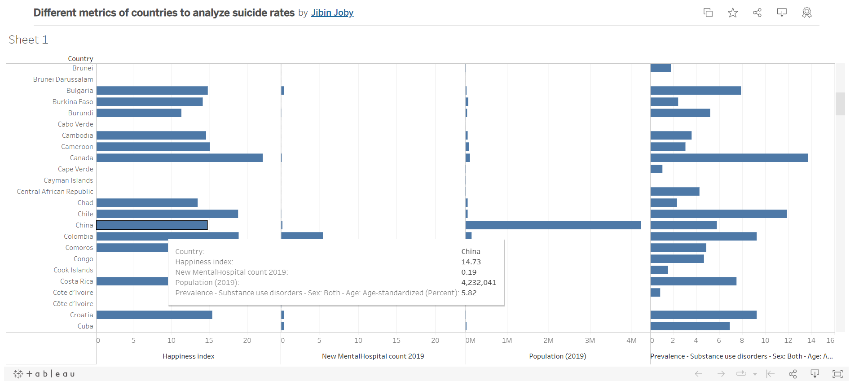
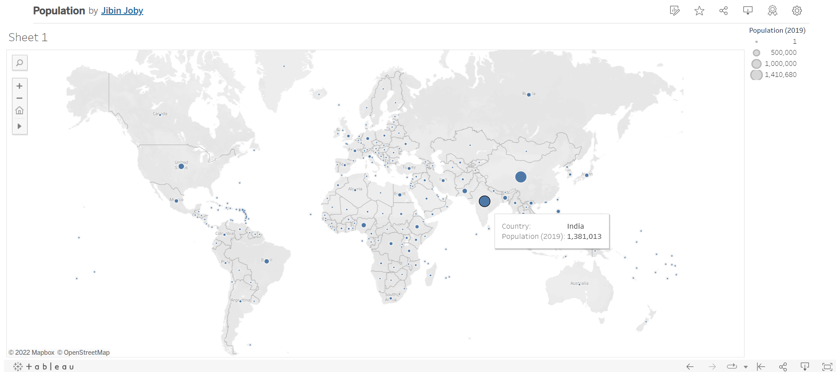
https://public.tableau.com/app/profile/jibin.joby/viz/Differentmetricsofcountriestoanalyzesuiciderates/Sheet1
https://public.tableau.com/app/profile/jibin.joby/viz/Population_16701195722750/Sheet1

Slide 14
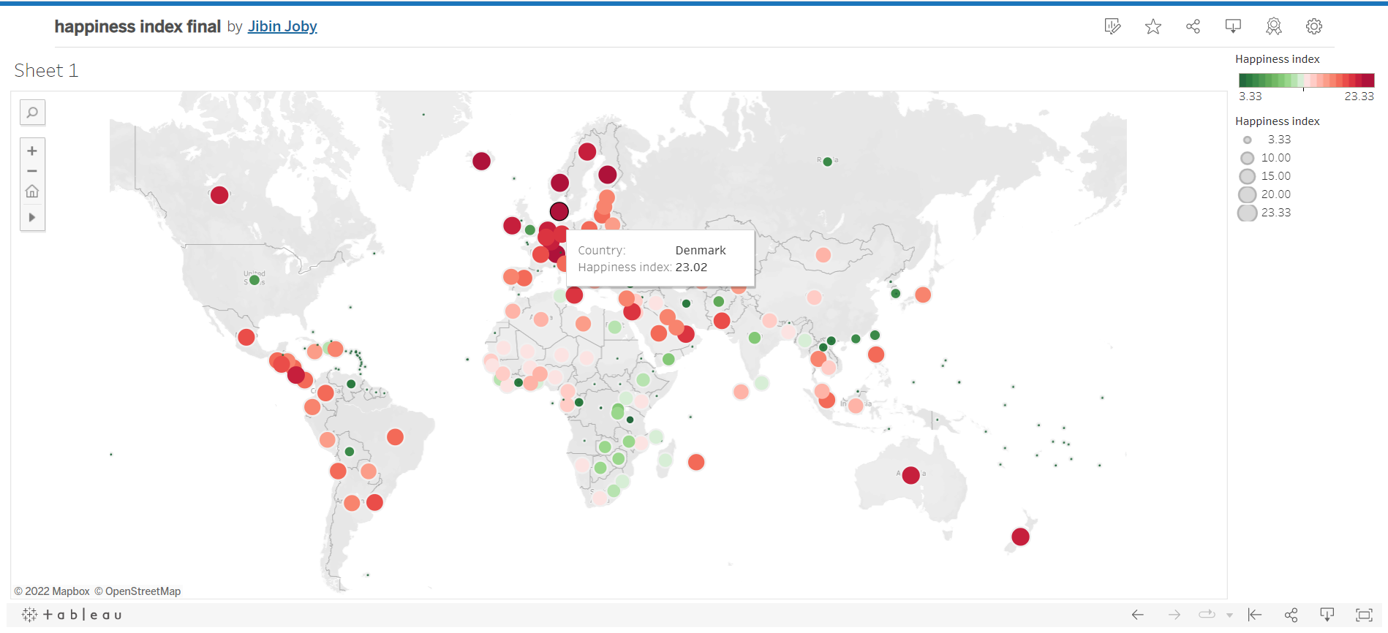
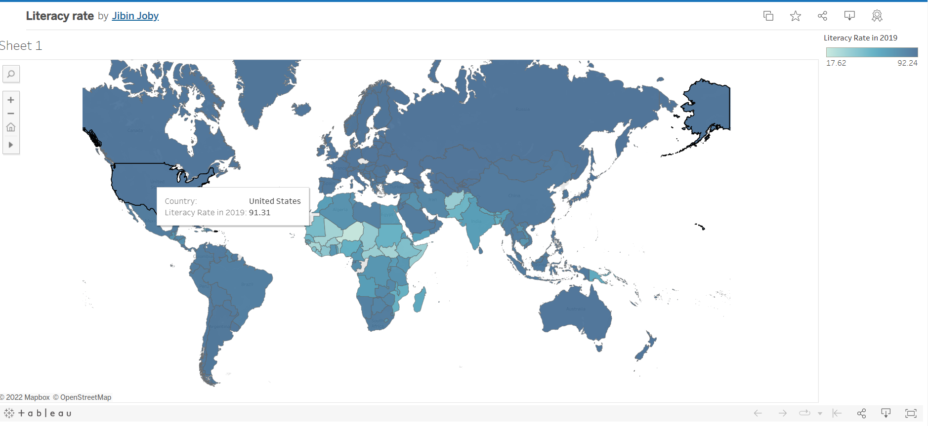
https://public.tableau.com/app/profile/jibin.joby/viz/happinessindexfinal/Sheet1
https://public.tableau.com/app/profile/jibin.joby/viz/Literacyrate_16701193808550/Sheet1

Slide 15
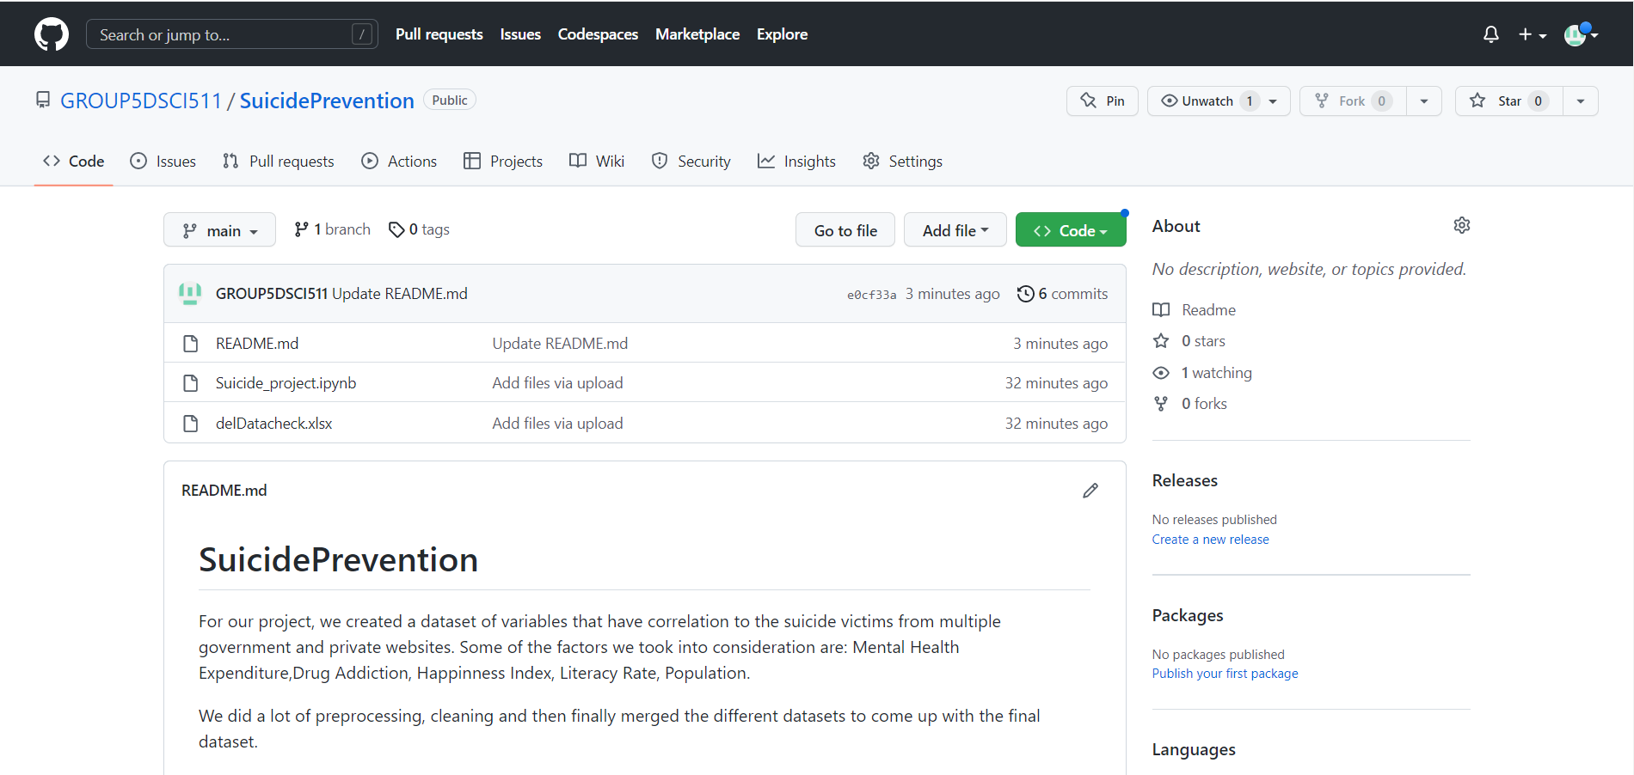
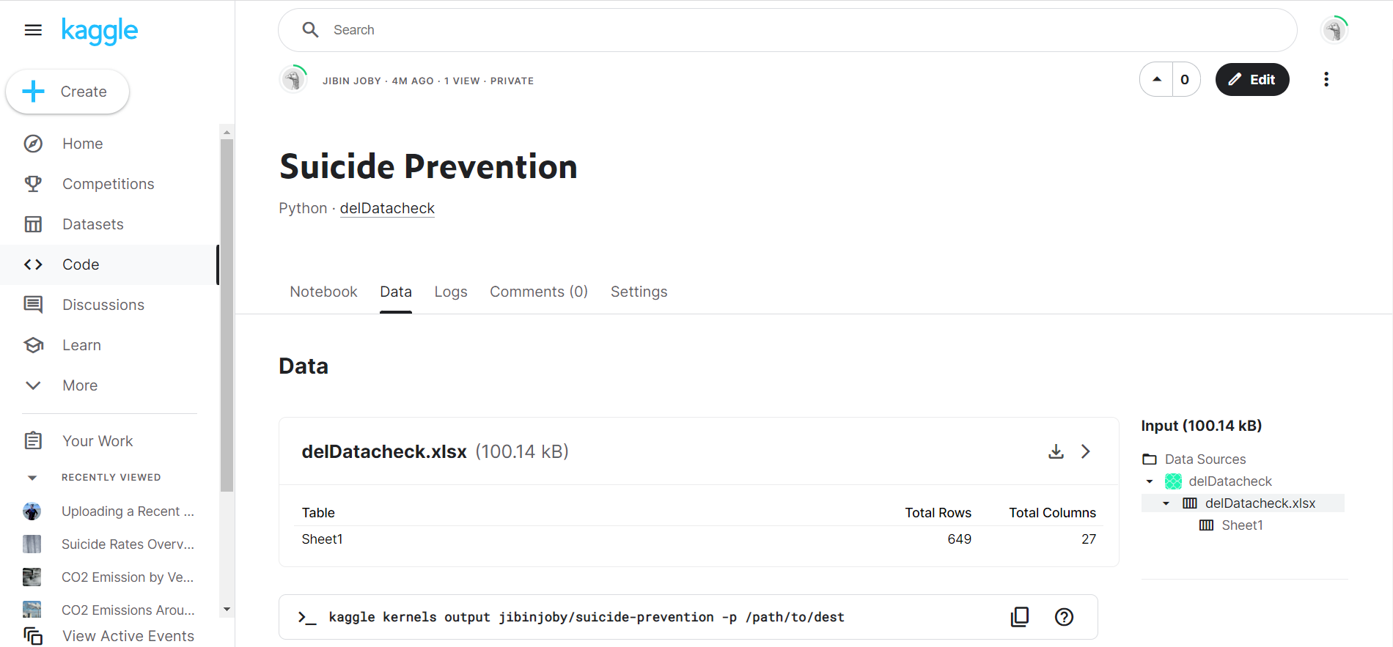
https://github.com/GROUP5DSCI511/SuicidePrevention
https://www.kaggle.com/code/jibinjoby/suicide-prevention/data

Slide 16
Conclusion
Through our project we believe to have provided multiple variables to concerned agencies to review the statistics for suicide in any given country.
By doing this the government, social workers etc could identify the problem in their system and try to fix the problem.
The dataset would help them narrow down on the problem related to the age, sex, location, inadequate policy for mental health, infrastructure etc. and move in the direction to reduce suicides.

